Slide 1

ANALYSING STOCK PRICES OF MAJOR INDIAN BANKS
FORECASTING THE CLOSE PRICES OF FOUR DIFFERENT BANKS using machine learning and time series methods

Slide 2
BANKS IN QUESTION
ICICI
HDFC
AXIS
SBI

Slide 3
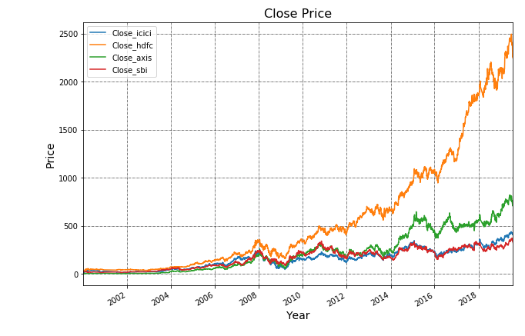
CLOSE PRICE VISUALIZATION

Slide 4
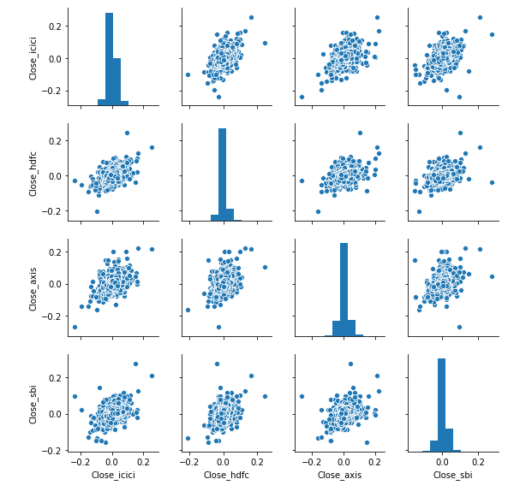
PLOTTING RETURNS OF EACH WITH RESPECT TO EACH OTHER

Slide 5
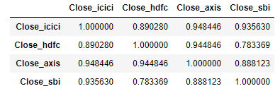
CORRELATIONS OF CLOSE PRICE

Slide 6
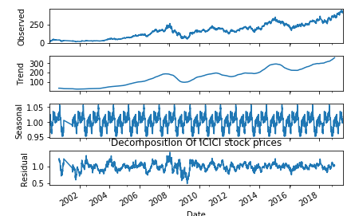
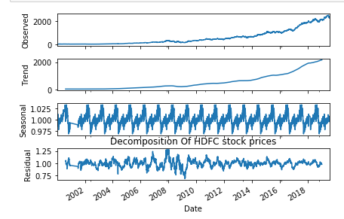
DECOMPOSITIONS OF ICICI AND HDFC
Decompositions of other 2 banks are available in the jupyter notebook

Slide 7
STATIONARITY
ALL 4 banks were found to be non-stationary in nature and hence had to be made stationary
The ADF(Augumented Dickey Fuller) test was done on them to check for stationarity
ICICI and SBI required only one order of differencing to make them stationary
Whereas HDFC and AXIS required a very large order of 10 and 20 respectively(which is not correct and will be addressed later)

Slide 8
MODELS USED
MOVING AVERAGE
ARIMA
Linear Regression

Slide 9
FEATURES CREATED (ONLY FOR LINEAR REGRESSION)
Mon_fri(1 for start of the week and for end of the week)
Start_end_month(1 for month starting and ending while zero for everything else)
Start_end_year(1 for starting and year ending while zero for rest)

Slide 10
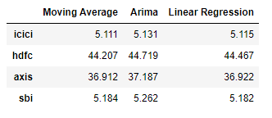
MODEL PERFORMANCE
All three models gave same RMSE for each of the banks
While there was a problem for hdfc and axis due to a large differencing value

Slide 11
MODELING ONLY ON RESIDUAL
For axis and HDFC to improve the RMSE modeling was done only on its residuals instead of whole component.
This is also a method of making the series stationary without having to get large values of differencing

Slide 12
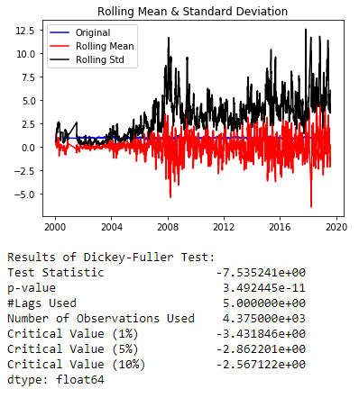
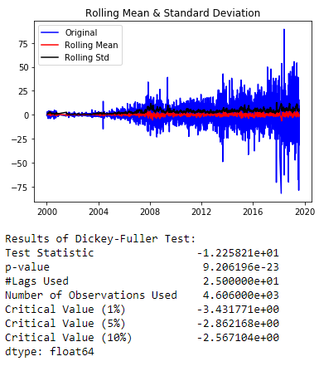
STATIONARITY after decomposing is on the left

Slide 13
RESULTS AFTER DECOMPOSING
Model performance of HDFC AND Axis improved considerably after Decomposing
RMSE of HDFC 0.48 and AXIS 0.42

Slide 14
CONCLUSION
Time series Forecasting especially Stock Price Forecasting is a very vast and mathematically complex domain
This Project only scratches the surface of how deep one can go into this topic
Furthermore News of the company is a very important factor for stock price changes and hence including news about that particular company can be done

